Slide 1
Excel Dashboard Presentation in Healthcare
Data Sheet link:
https://docs.google.com/spreadsheets/d/1okNX9KAbDQpK5xEb7eBgIFpMbM6NFjiDezI4NYoZsrg/edit?usp=sharing
Presented by
Maran Jeys J

Slide 2
Problem Statement:
A healthcare facility is facing challenges in optimizing its operational efficiency. The facility has a high patient volume and wants to identify areas for improvement in patient flow and resource allocation. They are looking to create a dashboard using Excel to visualize key metrics related to operational efficiency.

Slide 3
Objective:
The primary objective of this initiative is to enhance the operational efficiency of our healthcare facility with a high patient volume. Through data-driven insights and process improvements, we aim to reduce patient wait times, optimize resource allocation, improve patient throughput, and elevate overall patient satisfaction while maintaining the highest standards of quality and compliance.

Slide 4
Insights:
Wait Time Reduction
Resource Allocation Optimization
Appointment Scheduling Accuracy
Patient Satisfaction Improvement
Staff Productivity Enhancement

Slide 5
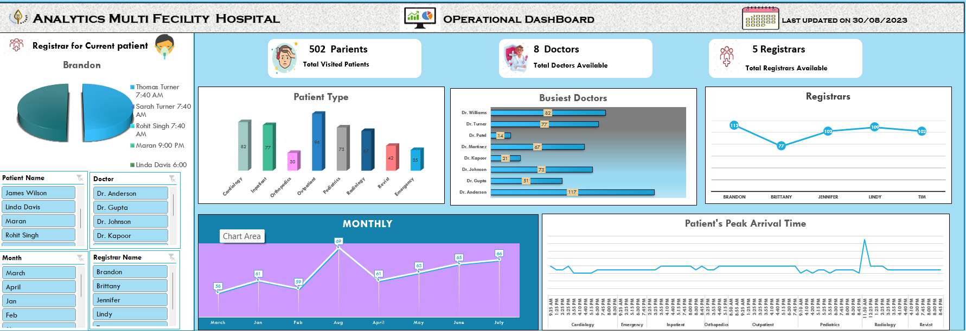
Dashboard Picture :

Slide 6
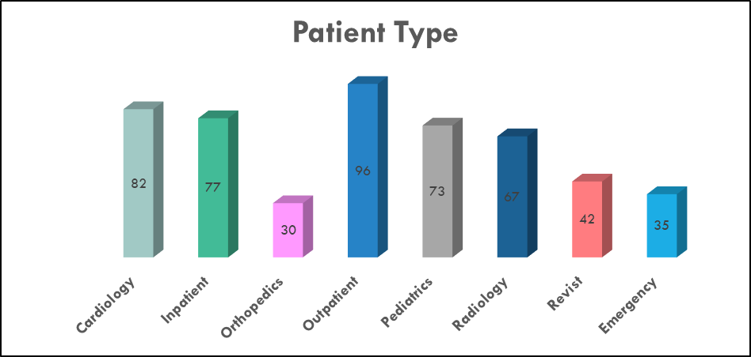

Slide 7
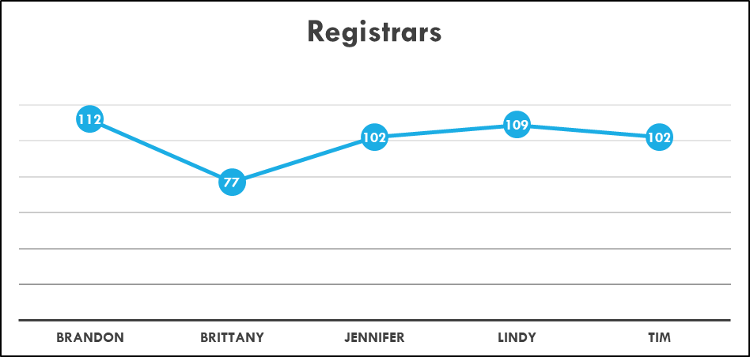

Slide 8
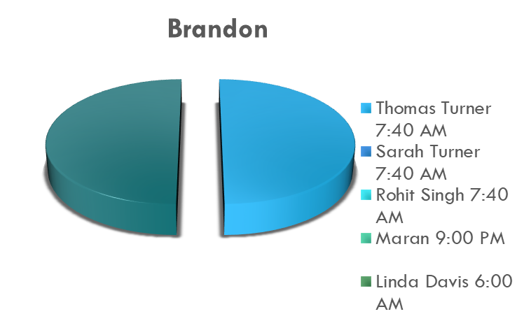

Slide 9
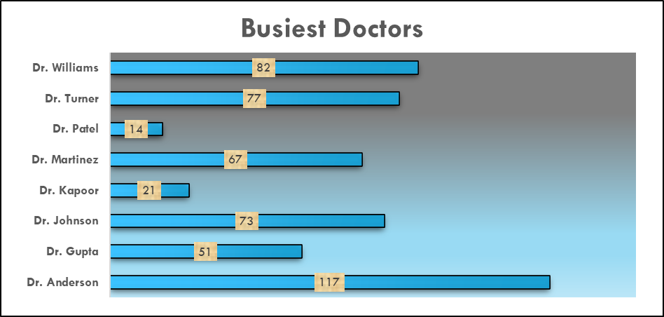

Slide 10
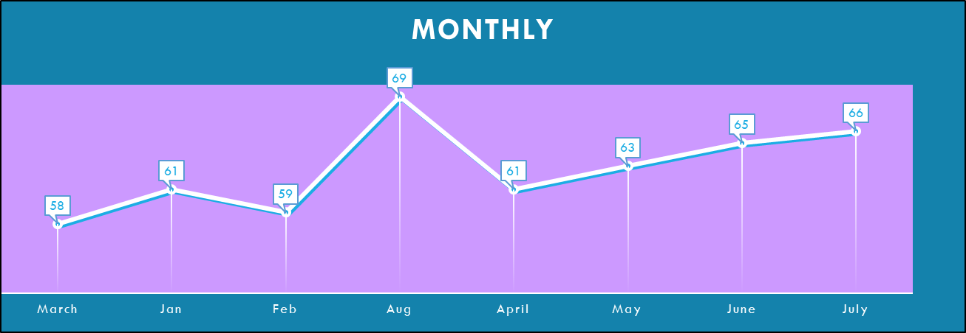

Slide 11
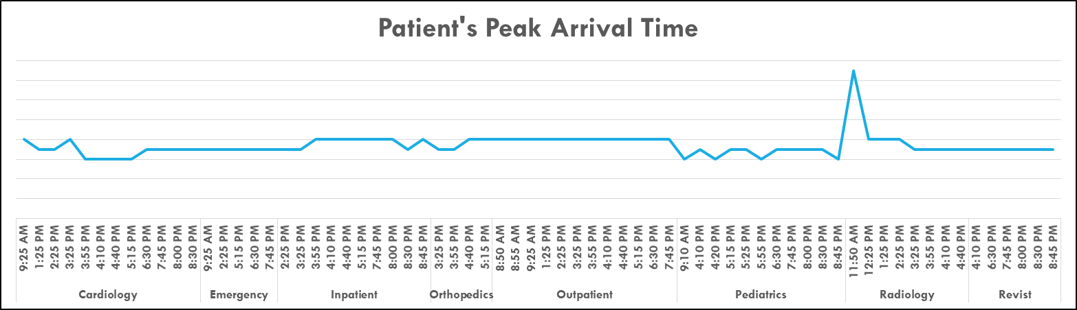

Slide 12
Conclusion:
In conclusion, our efforts to optimize operational efficiency in our healthcare facility are guided by a commitment to delivering exceptional patient care while utilizing resources effectively. Through data-driven insights, process improvements, and the dedication of our healthcare team.
These initiatives will position our healthcare facility as a leader in providing high-quality care and improving operational efficiency in the healthcare industry.

